Slide 1

Big Bazaar Sales Prediction

Slide 2
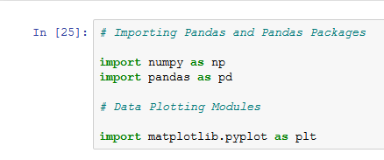
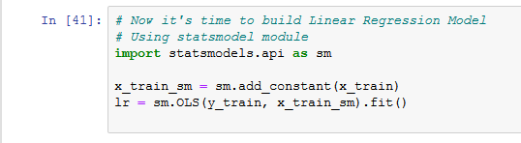

PYTHON MODUES
Python Modules used for this project are Numpy, Pandas, Statmodels.api, sklearn.metrics and matplotlib.pyplot

Slide 3
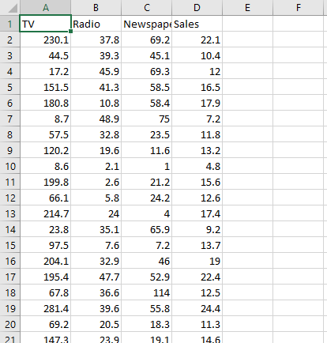
OBJECTIVE
Objective of this project is to predict Big Bazaar sales based on different medium of advertisement..

Slide 4
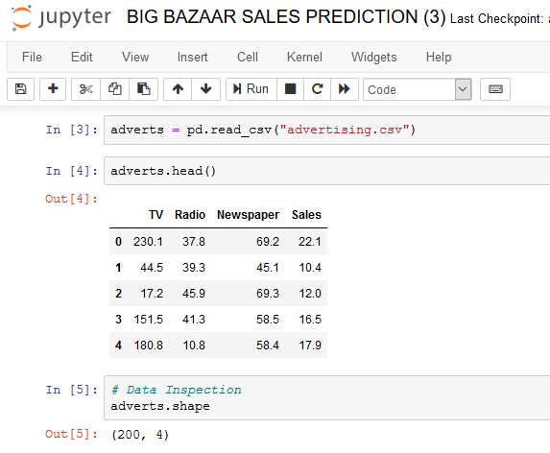
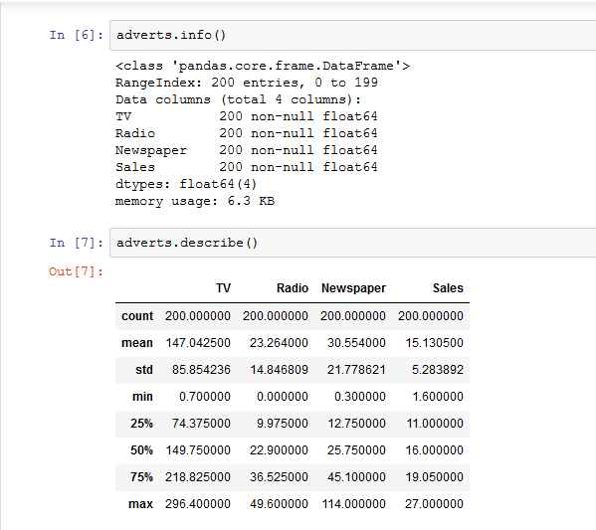
DATA EXPLORATION
A quick glance on the data attributes and it’s datatypes.
Examining the attributes by looking at the statistics of the numeric variables.

Slide 5
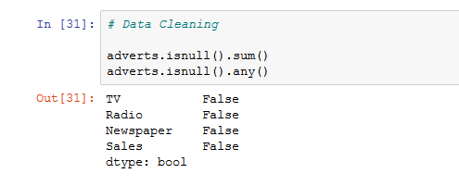
DATA CLEANING
Checking for missing values from rows of the dataset.
Eliminating them from each of the tuple where values or null values are found.

Slide 6
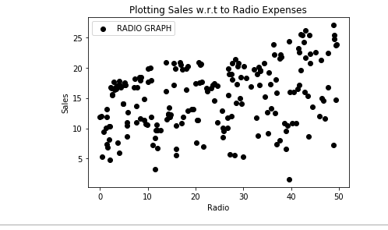
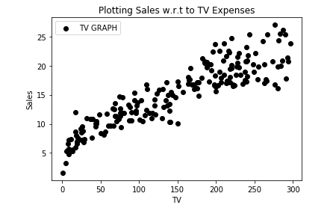
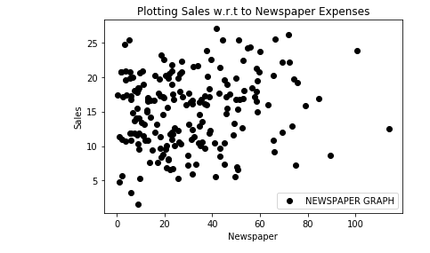
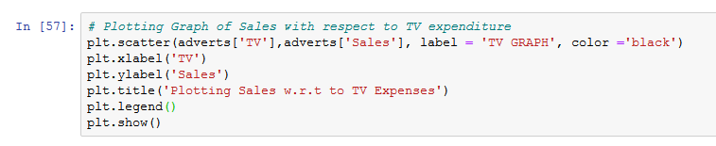
PLOTTING OF DATASET
We plot TV, Newspaper and Radio data with respect to Sales data to find a proper pattern which satisfy a certain linear equation.
Out of three plotting only one we can use to for prediction i.e. Plotting TV w.r.t Sales.

Slide 7
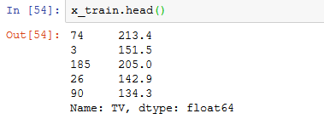
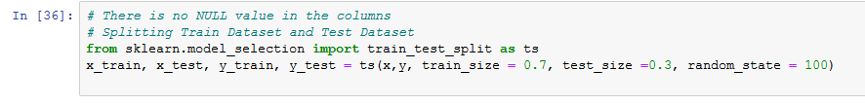
SPLITING THE DATA INTO TRAINING AND TEST SET
SPLITING THE 70% OF THE DATA INTO TRAINING SET AND 30% INTO TEST SET

